Slide 1
Real-Time Evolving Deep Learning Model for S&P 500 Momentum and Sentiment Prediction For Portfolio management MTH 601: Mathematics of Deep Learning NIKHILESH NARKHEDE (02196141)

Slide 2
Problem Statement
How can we accurately predict future stock movement by combining historical prices and real-time news sentiment, while adapting models over time?
Problem 1: Momentum Price Prediction
Challenge: Predict future stock prices using only past price history.
Why hard:
Non-linear patterns.
Noise in financial time series.
Need enough lead time for decision making (you chose 7 days ahead).
Problem 2: News Sentiment Prediction
Challenge: Predict bullish or bearish movement based on daily news.
Why hard:
Natural language is unstructured and noisy.
Same news can affect different stocks differently.
Massive volume of news every day.

Slide 3
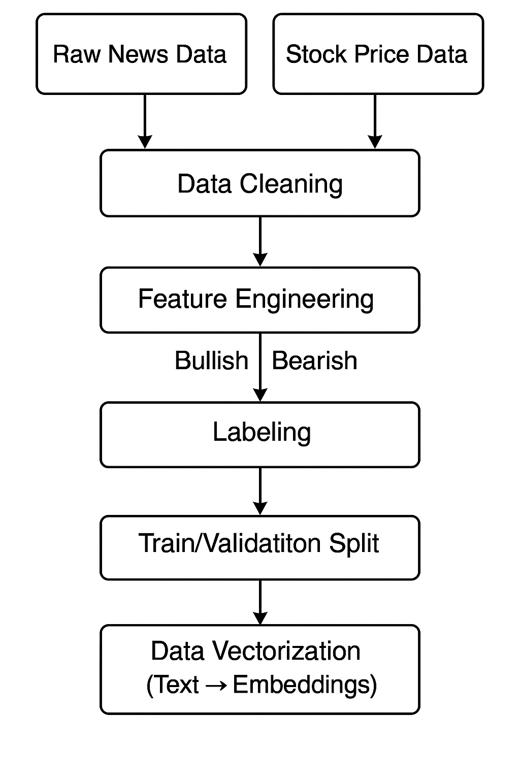
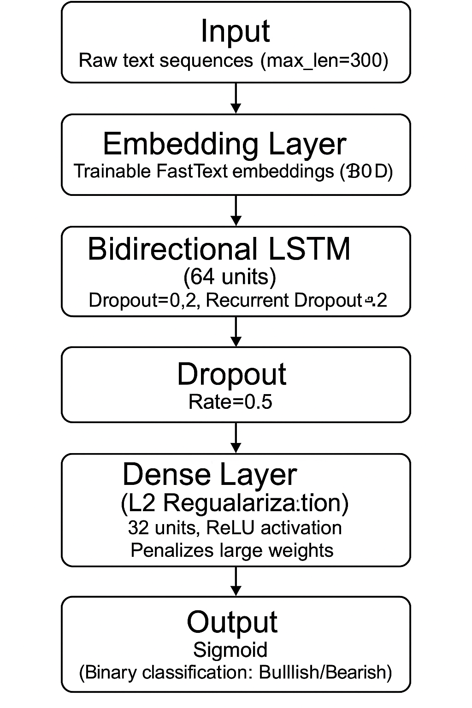
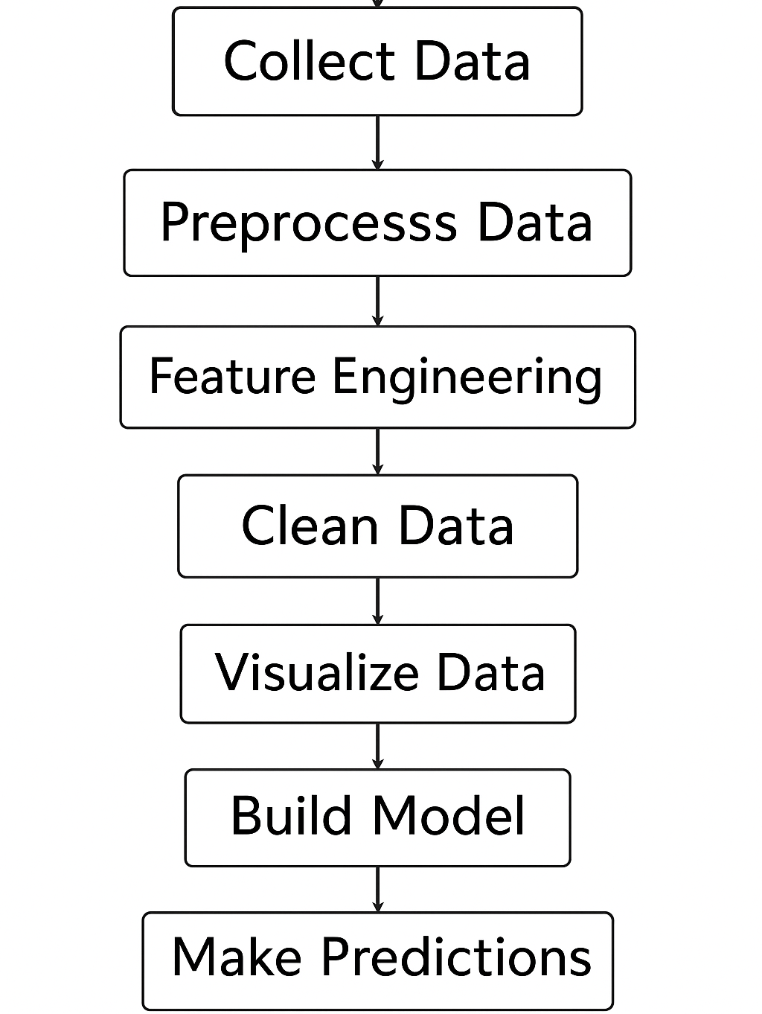
Architecture
News Data web scraping
NLP Model
LSTM Model

Slide 4
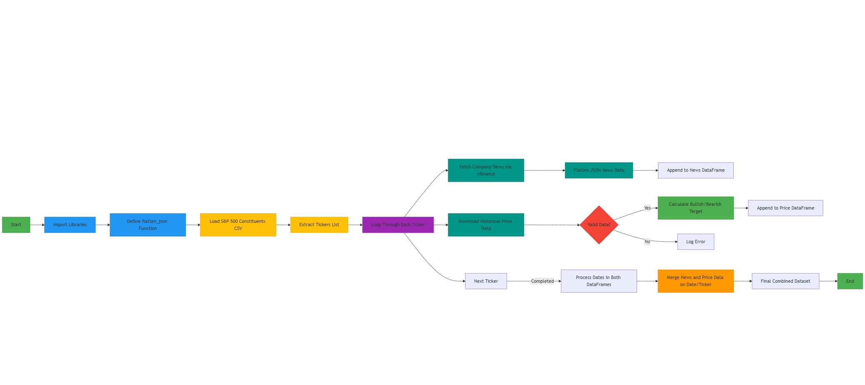
Architecture
News Data web scraping

Slide 5
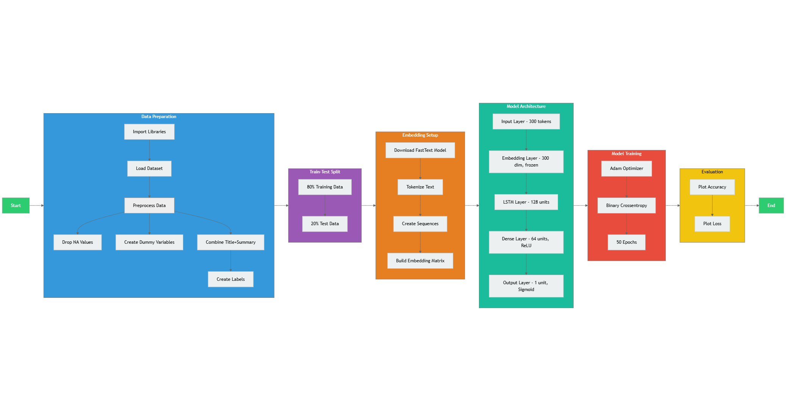
Architecture
NLP Model

Slide 6

Architecture
LSTM Model

Slide 7
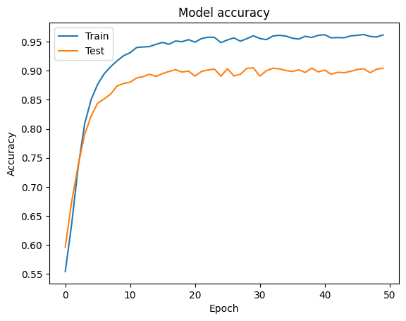
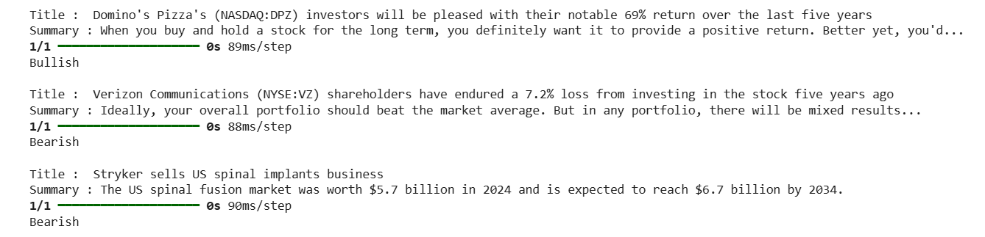
Result (News Perseverance sentiment )

Slide 8
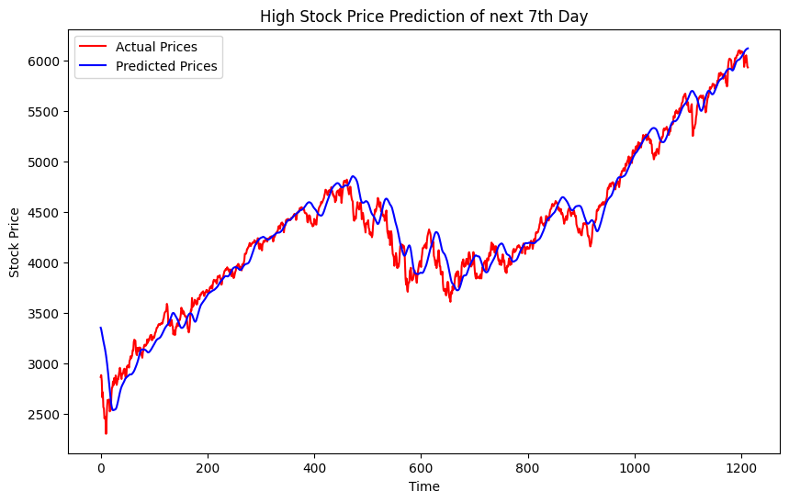
Result (Stock Price Momentum Prediction )

Slide 9
Conclusion
Price Prediction validation R² = 97%
Sentiment Prediction validation Accuracy = 90.1%
Successful Real-time Evolution
Practical for user research with a 7-day window
Continuously retraining the model with new data batches.
Prevents model drift and adapts to changing market conditions.
Using these tools might be subject to biased news data. Please consider before using it.

Slide 10
Future Work
Use transformer models like FinBERT for sentiment.
Expand to multi-stock portfolio predictions.
Explore reinforcement learning for trading strategies.
Thank You

